Slide 1
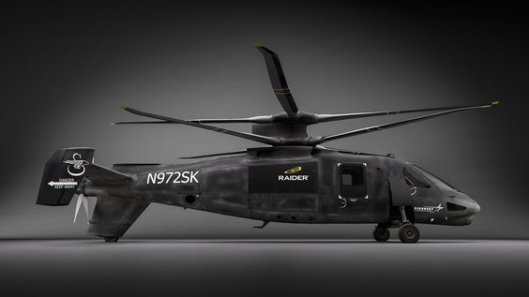
Future Fast Rotorcraft Progress Meeting 02 – 11/10/2023
Y.J.E. Prencipe

Slide 2
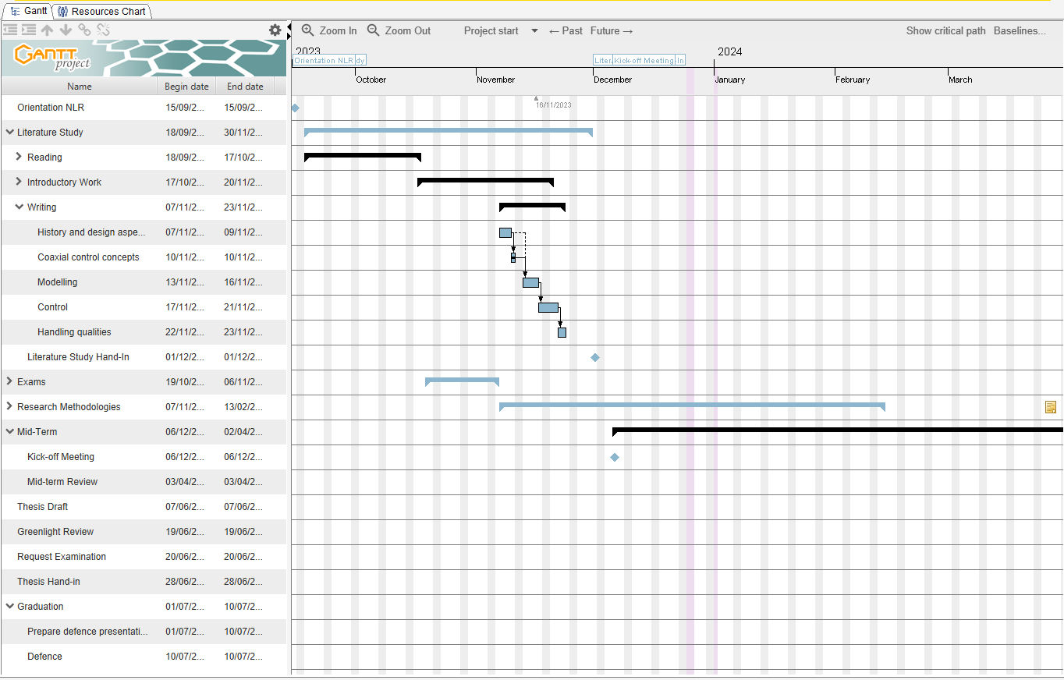
Progress Overview Week 5-6 (accounted for 3 weeks studying+exams)
This is week 7 (22/11/23)
Exams went well – passed Electronics, waiting for (positive) result Noise and Emission → kick-off soon?
Gantt chart, to be edited
Writing (a lot) – see Overleaf
History
Design Aspects
ABC, Control sys, AVC
Modeling
Rotor inflow
Lit overview, BET, SMT, LMT (PittPeters, Leishman, ..), Interference Effects, Wake contraction effects, Blade dynamics

Slide 3
Progress Overview Week 5-6
Lit overview, BET, SMT, LMT (PittPeters, Leishman, ..), Interference Effects, Wake contraction effects, Blade dynamics
Propeller modelling
Fuselage modelling
Horziontal stabilizer, vertical stabilizer, elevator and rudder modelling
Next:
more writing: control strategies + control allocation (6-8 days), handling qualities (3-5 days)
Initial modelling analysis for coax heli as discussed before?
Lit study deadline? – between 1-5 dec without initial modelling, end of year with initial modelling

Slide 4
Progress Overview Week 5-6
Overall really enjoying the thesis, learning a lot, wishing to learn lots more

